Slide 1
List Eaters
A solution to streamline Texas A&M University’s student ticket-pull process
Product Owner: Jon Waterman
Scrum Master: Kareem Hirani
Developers: Reid Neason & Baldwin Bakkal

Slide 2
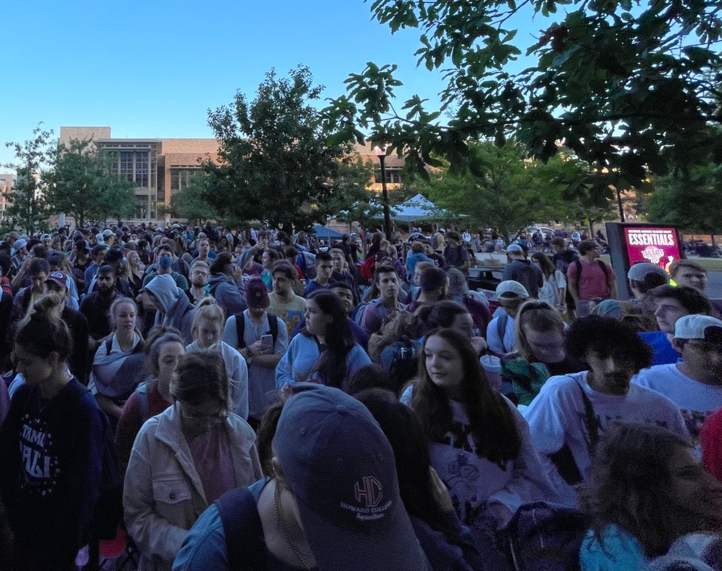
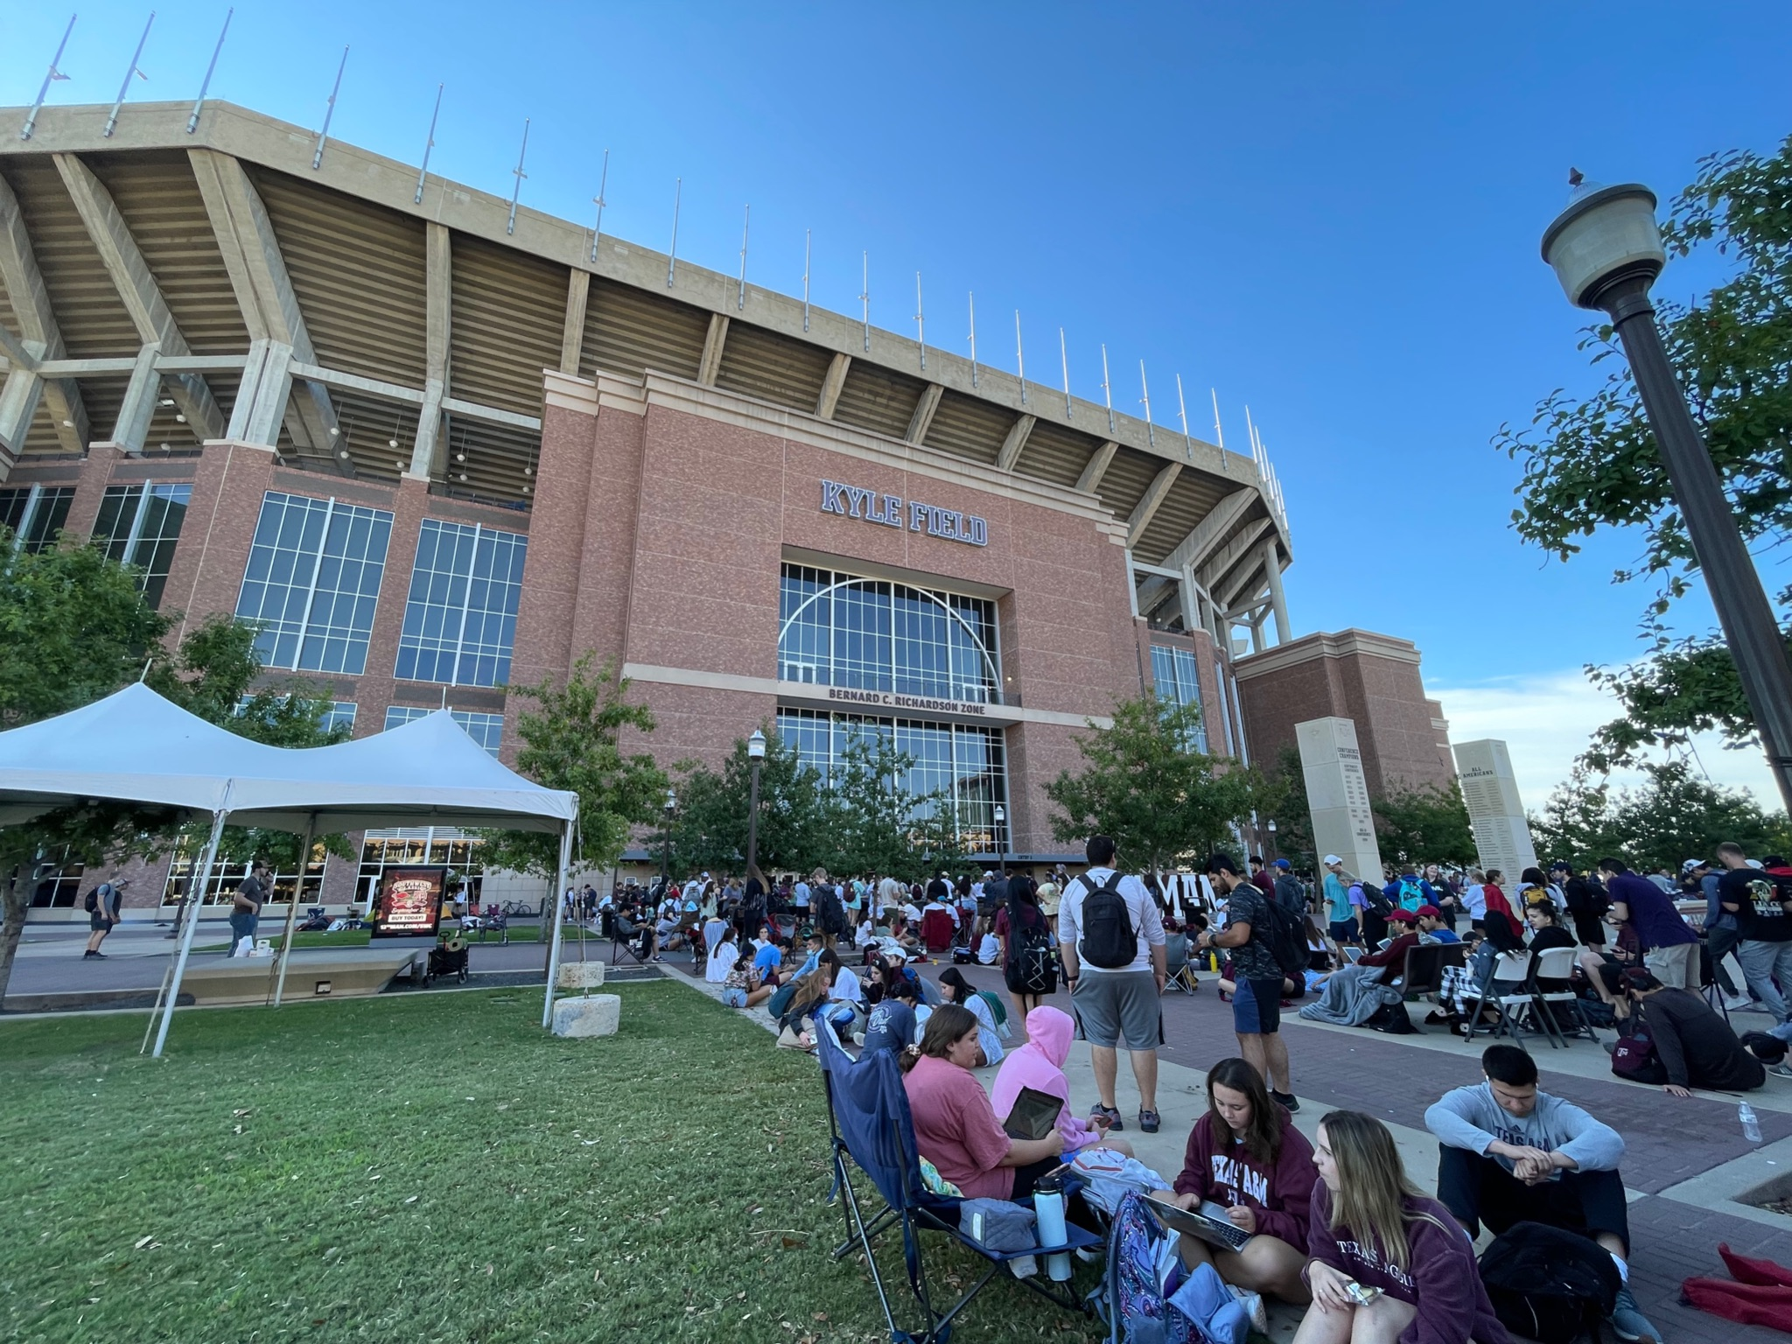
The Problem
The current ticket pull system can be incredibly inefficient
Scavenger hunt for everyone’s sport passes
Unprepared students can hold up the line
Workers have to scan every single pass in a group to print tickets
Results in hours-long lines, forcing students to either skip class or give up their spot in line
Who wants to miss Professor Lightfoot’s 8 AM Cloud Computing class?
12th Man Foundation has to pay staffing costs for a large workforce to accommodate this
Notes:
Jon

Slide 3
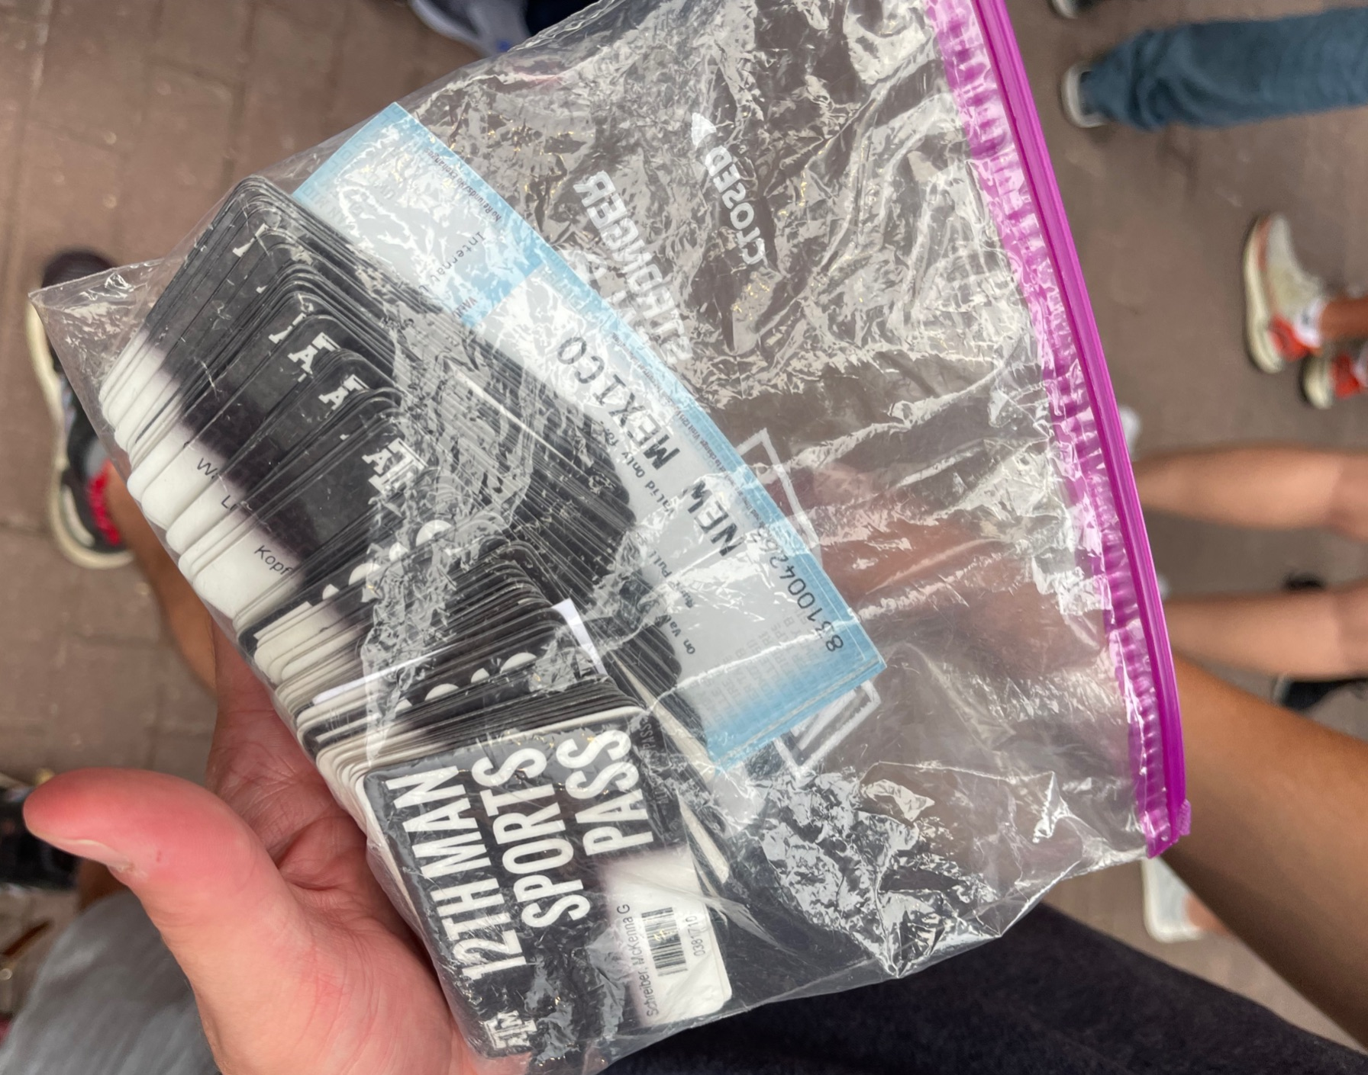
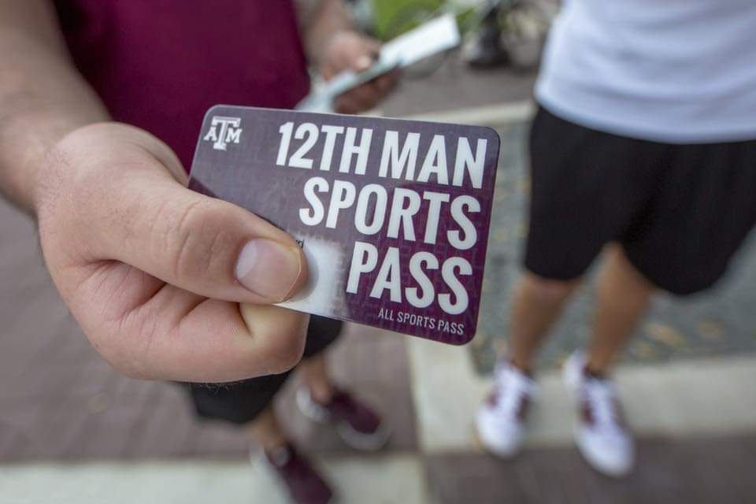
How can we make it better?
Allow groups to form virtually in advance of pulling
Eliminate the need to collect & swipe every single sports pass in a group
Scan a single QR code to pull everyone’s tickets in that group
Make the process largely virtual while still maintaining tradition & camaraderie of in-person pulling
Notes:
Jon

Slide 4
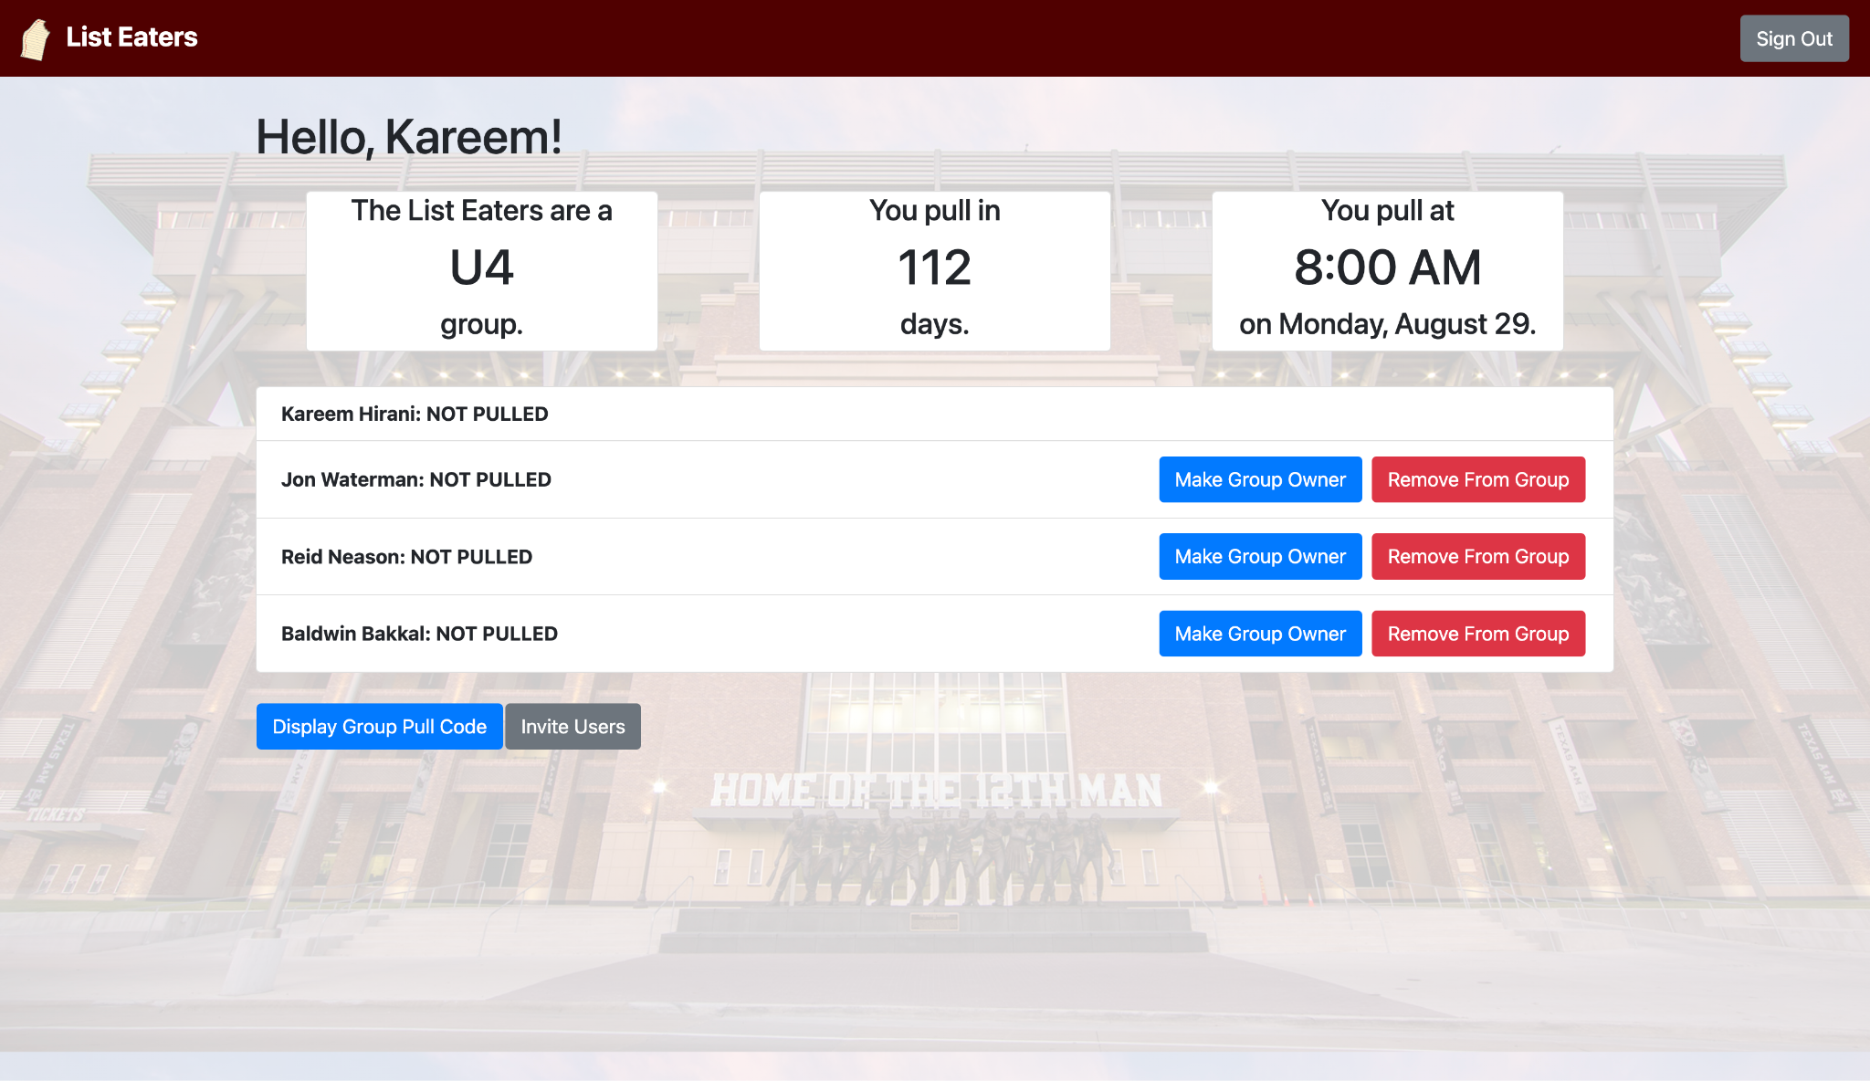
Our Solution - The Student Side
Students can create their own pull groups and send invites to friends
System automatically calculates when they are able to pull based on group member classification and displays countdown
Each group has a unique QR code that contains each person’s information to pull tickets
On their pull day, only one member of the group needs to show up to scan the group’s QR code to pull the entire group’s tickets
Notes:
Kareem

Slide 5
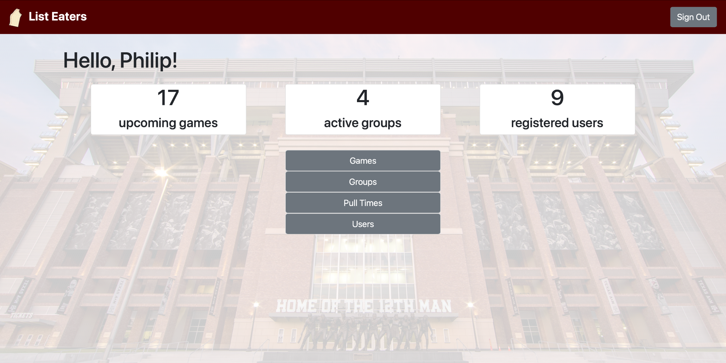
Our Solution - The Admin Side
Site administrators have full control over all aspects of the site
Can create/update/delete games, pull groups, student accounts
Can change pull times/dates for special scenarios
i.e. Freshmen pull on Wednesday due to Thanksgiving
Groups reset after each game to make mobility between groups easier
Notes:
Reid

Slide 6
Benefits
Lines will move much faster than before
Groups have been arranged beforehand
Single QR code scan will replace swiping every sports pass
Students don’t have to choose between good seats or good grades
Physical presence and tradition of ticket pulling remains intact
12th Man Foundation decreases staffing costs, potential to increase revenue
Can staff fewer people due to fewer lines being needed or reassign employees to other areas
Easier & faster ticket pulling method will encourage more students to purchase a sports pass
Notes:
Speaker: Baldwin

Slide 7
SE Design Process
Two paths taken:
Behavior-Driven Design
Test-Driven Design
Team communication
Frequent small updates >> infrequent larger updates
Daily standup meetings make work more manageable
Notes:
Speaker: Baldwin
Made it easier for keeping everyone on the same page and informed. Easier to push out and complete user stories.

Slide 8
T’s & G’s

